Slide 1
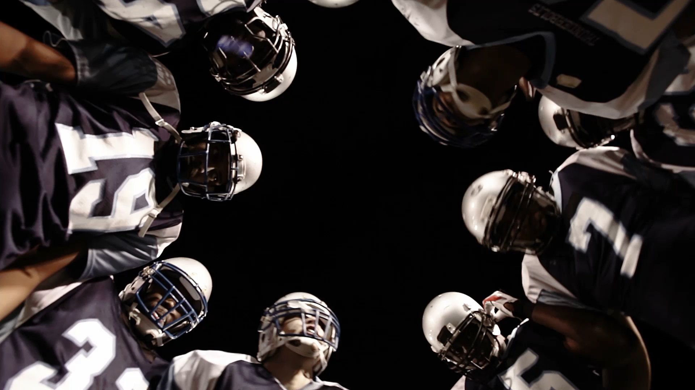
Getting Under and Over Vegas NFL Lines
By: Matthew Nykaza
April 5th, 2021

Slide 2
Outline
Business Problem
Data
Model
Conclusion
Future Work

Slide 3
Business Problem
Vegas has advanced models used to create their lines
Both average and professional gamblers can struggle to beat Vegas
Create a program in which all someone needs is basic game data
Generate an accurate prediction based off that data

Slide 4

Data
NFL games, stadiums and teams 1978-2021
Handling missing data
Engineering features
Reviewing correlations
Prepare for modeling

Slide 5
Modeling
Tree Based Model
54% Accurate

Slide 6
Conclusion
Model not ready as a finished product
Only negligibly better than guessing
Need more data on individual teams
Passing, rushing, defense, etc.
Evident that beating Vegas at their own game is difficult
Whole teams of people who’s job is to create these models

Slide 7
Future Work
Individual team data
More year-by-year statistics
New modeling techniques
Better engineering of features

Slide 8
Thank you!!!
Email: MATT.CS.NYKAZA@GMAIL.COM
Github: @MxCxSxN
LinkedIn: https://www.linkedin.com/in/matthew-nykaza-8a0b726a/

